Slide 1
SWEN
Done By Ronald, Faizal, Syazwani, Mervin

Slide 2
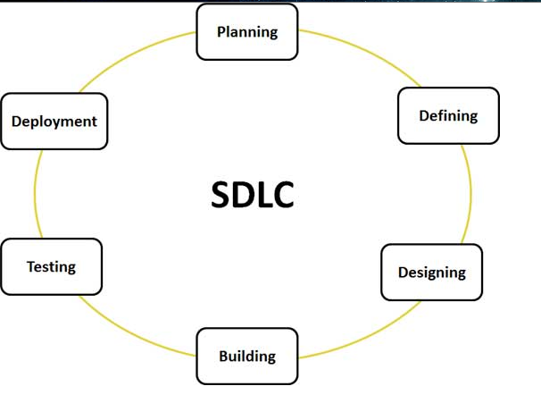
Ronald - SDLC
Stands for “Software Development Life Cycle”
A series of phrases, providing models for development and management of a software.
The phrases start from an inception of ideas and all to the last phrase the deployment of software.
Models such as waterfall, Unified Process (UP) and Agile Method taken into consideration when developing software

Slide 3
Ronald - Why SDLC?
Cost efficient
Much active than other software developed
Stable and reliable to be consumer by customers.
Higher quality software developed.
SDLC models are easy to execute and understand.

Slide 4
Ronald – SDLC Models
Waterfall model
Dividing task into smaller components making it more manageable.
Each task produce quality results that aid to the project as a whole.
Activities are deal one at a time.
Prevent stockpiling errors and hinder software developments.
Most suitable for software developing software that are previous available.
Visibility of the outcome of the software is clear roughly.

Slide 5
Ronald – SDLC Models
Unified Process (UP)
Develops software process in iterations fashion.
Each phrase will consist of one or more iterations.
Each of the iteration will consist of analysis, designs, coding and testing.
Iteration method in UP models allows software first developed in small scale
All the steps taken are carefully monitor.
Each cycle will produces a better version software compared to the last.
The process will carry on until the software is developed.

Slide 6
Ronald – SDLC Models
Agile
Provides opportunities to assess the direction throughout the development lifecycle.
Regular cadences of work also know as sprints.
Produces a shippable product increment.
Focus on repetition of abbreviated work cycles as well as functional product the team wish to develop.
Every phrase of development from requirements to design is continually revisited
Using “inspect and adapt” approach to reduces the development cost and time to market.
Agile development helps corporates to build the right system/software.
Agile will be empower earns to repeatedly re-plan their release to optimize its value throughout the development.

Slide 7
Ronald – TOR - Objective
Develop a booking system usable by customers and staff.
Allowing customers to book hotel rooms via Internet by themselves.
Implementing payment module to allow easy payment via the Internet to hotel for booking.
Customers are able to manage and view hotel bookings.
Customers are able to update and cancel bookings via their account.
Also develop a housekeeping system plan and monitor cleaning schedules.
Allowing on desk staff at the counter to know the status of the room.
Improving communication between cleaning crew and counter staff.
Hence, efficient service will be provided, assuring a comfortable stay for clients.

Slide 8
Ronald - Project Plan - Project Scheduling
HMS software development plan
Development team: Faizal, Ronald, Syazwani & Mervin
Starting date: 21 April 2015
Release date: 8 June 2015
Total days: 35 days
Five phrases: Planning, Design, Prototype1, Prototype 2, Prototype 3 and deployment. (Order from left to right)
5 milestones included

Slide 9
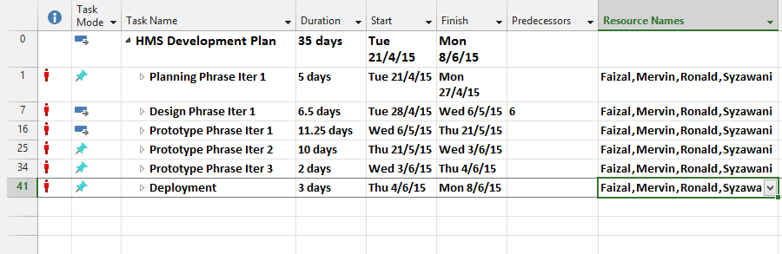
Ronald - Project Plan - Project Scheduling

Slide 10
Faizal - SDLC
Phases
Requirements
Consolidation of Software Specifications and Details
Design
Design of Software inclusive of Graphic User Interface (GUI), architectural and database design
Implementation
Conversion of Design and Software Specifications into codes
Testing
Quality checking for the final Software to see if all functions are working and client is satisfied
Deployment
Release/Transfer of the software to the client or for public purchase

Slide 11
Faizal - SDLC
Models
Waterfall model
Goes through the 5 phases of the SDLC mentioned in a flowing manner from the first to the last, 1 by 1
Prototyping
Throwaway - Prototype built with the outline specification and is tested with user/client and is redone till the user’s satisfaction. A new set of specification is produced and software is built based on that. Prototype is being thrown away.
Evolutionary - Prototype built with the initial specification and is tested with user/client and is refined and implemented with more parts till the user’s satisfaction and the software is complete.

Slide 12
Faizal - SDLC
Models
Unified Process
4 phases - Inception, Elaboration, Construction and Transition.
Each and every iteration consists of all the steps of the SDLC. Processes such as business modelling are done more at the start compared to the end. Vice versa for Implementation

Slide 13
Faizal – TOR - Scope
Hotel guests view available rooms and its type in the hotel through checking the system instantly through the website*
Hotel guests book their preferred rooms in the hotel by themselves and update/delete their bookings in the system by entering their particulars and making payment*
Housekeeping system - Staff in charge of the room maintenance services identify the rooms in need of service/cleaning through a dashboard in the system.
Online chat system - A chat box in the website for customers to communicate with the staff so that they can make enquiries instantly.
*Hotel staff able to do these processes directly in the system itself on behalf of the hotel guests

Slide 14
Faizal – TOR – Approach and Methodology
Team is adopting the Evolutionary Prototyping model.
Reasons
Time is limited (only 8 weeks)
Throwaway Prototyping requires building a new system based on the new specifications taking time
Waterfall and Unified Process models takes too much of the time spent on planning and design. Very less time left for implementation (coding).

Slide 15
Faizal – TOR – Approach and Methodology
Problems
Prototype never stops refinement as Mr. Wang may keep making changes in the system to make it more perfect (e.g. adding a new feature) taking too much time
Team spends too much time on one feature leaving little time to do the rest of the features.
Solutions
Team will draw up an initial specification which is detailed unlike normal prototyping. This will help us to plan our time properly so that the prototype needs the least refinement to be completed as a system.
Team will come up with a proper time plan and work distribution list where all the development is planned out.

Slide 16
Faizal - Project Plan - Work Breakdown
4 Phases-
1st - Requirements/Specifications Gathering
2nd - Database creation, Prototype Building (Booking System, Housekeeping System, Communications system)
3rd - Prototype Testing & Refinement
4th – Implementation of final Systems

Slide 17
Syazwani - SDLC
Sequence of steps that provide model for the development and lifecycle management of an application or software
Describe a process for planning, creating, testing, and deploying an information system
Defines a methodology for improving the quality of software and the overall development process
ISO/IEC 12207 is an international standard for software life-cycle processes.
It aims to be the standard that defines all the tasks required and represent processes that establish a life cycle for application or software to provide development, acquisition, and configuration on maintaining the software

Slide 18
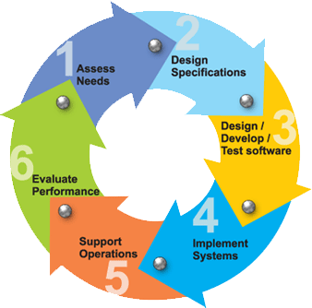
Syazwani - SDLC
Requirement gathering and analysis
Questions asked during the meeting with managers, stakeholders were analyzed for their validity and the possibility of incorporating the requirements in the system
Design
The System Design would help to specify hardware, system requirements and helps in defining the overall system architecture
Implementation
The work is divided into units followed by starting of the actual coding.
Testing
The codes were tested against the requirement. During this phase of unit testing, integration, testing, system testing and acceptance testing were done.
Deployment
Once successful, it is delivered or deployed to the customer for their use.
Maintenance
It is normal for customers to receive problems from the product from time to time.

Slide 19
Syazwani - SDLC
Waterfall Model
Each phase must be fully completed in order for the next phase to begin
Used for smaller project, as there are no indeterminate requirements
Review to verify if the project is on the right path at the end of the project and to decide whether or not to continue or discard the project
V-Model
Each phase should be completed before the next phase begins
Testing of the product is planned in parallel with a corresponding phase of development
Both Business Requirement Specifications (BRS) and System Requirement Specifications (SRS) requirement are needed to begin the life cycle model
Before development starts, a system test plan is created. This test plan focuses on meeting the functionality specified in the requirements gathering
Spiral Model
Four phases: Planning, Risk Analysis, Engineering and Evaluation Phases
Planning Phase: BRS and SRS are gathered during this phase
Risk Analysis: A process is commenced to identify risk and alternate solutions. A prototype is produced at the end so that if any risk is found during the then alternate solutions are suggested and implemented
Engineering Phase: Software and testing is developed
Evaluation phase: This phase allows the customer to evaluate the output of the project to date before the project continues to the next spiral

Slide 20
Syazwani – TOR – Product Positioning
Self-Check In and Self-Check Out
Hotel staffs will have to assign rooms for the guests through the system before the self-check in is confirmed to avoid any mistakes in the room allocation of the users
Self-check out will include the final payment of any extra charges if applicable before the customer can confirm the check out
Online Help Desk Feature
Provide customers to communicate with the hotel staff
Staffs assigned to manage interactions with customers through the website
Online chat for all customers
Ask any queries through the chat and will be getting prompt replies

Slide 21
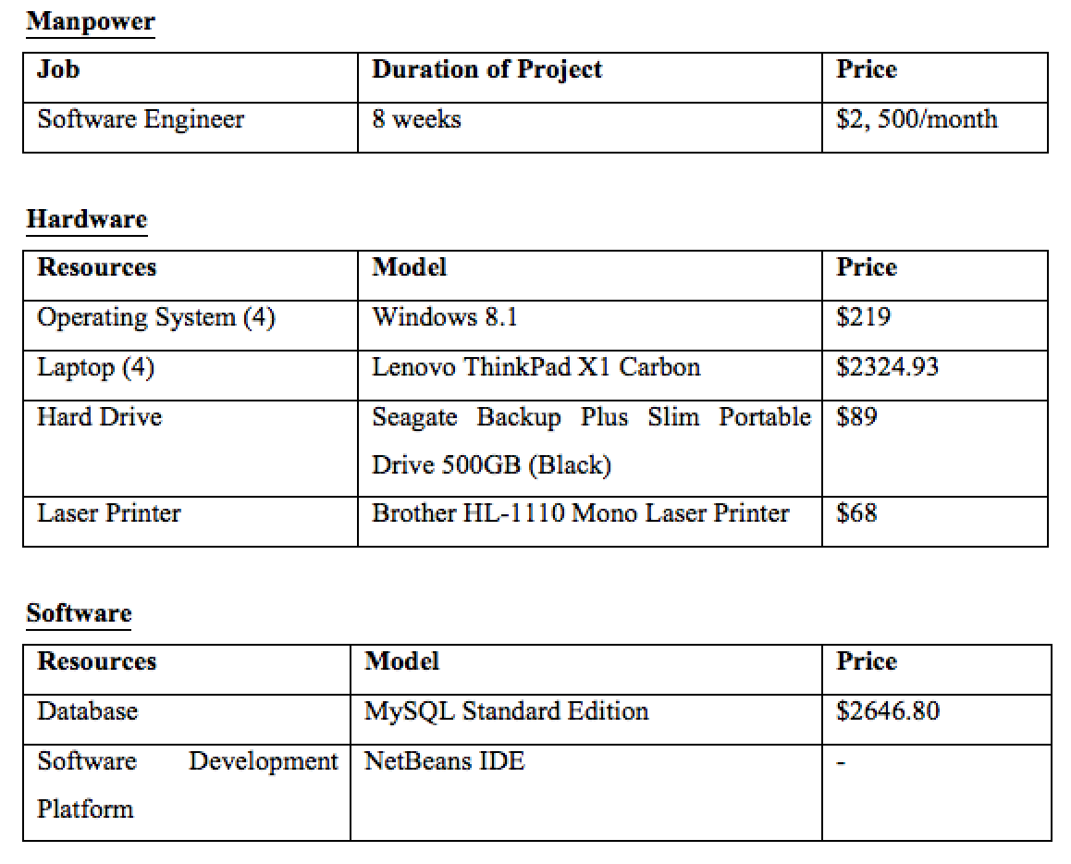
Syazwani - Project Plan - Budget Planning
Based on the resources needed, the total budget is $32, 979.52.

Slide 22
Mervin - SDLC
Software Development Life Cycle (SDLC)
Describes process of planning, creating, testing, and deploying an information system
Ambiguous, organized sequence of stages to develop a software product
Designs and develops a software product by providing a list of steps
Developers can select strategy to develop the software with aid of software development paradigm
Examples of paradigms:
Waterfall Model
Big Bang Model
Spiral Model

Slide 23
Mervin – TOR - Constraints & Resources
Constraints
Availability of the labs as the labs might have been used for others’ lessons
Other projects we have in hand which will take up a lot of our time
Group members’ different schedules will cost us to be inefficient as we are not able to work together most of the time
Resources
Hardware
Operating System (Eg. Windows, Linux) - Supports all known operating systems
Laptop (Eg. Lenovo ThinkPad X1 Carbon) - At least 512MB RAM, minimum screen resolution 1024x768 and a mouse
Hard Drive - Minimum 10GB free space
Laser Printer
Software
Database (Eg. MySQL) - Able to run on any platform above Microsoft Windows 7 (32 bit)
Software Development Platform (Eg. Netbeans IDE) - Able to run on any platform above Microsoft Windows 7 (32 bit)

Slide 24
Mervin - Project Plan - Risk Management
Possible project risks
Bugs in the system which might cause the system to crash or not function as proper
System might be hacked by other hackers
Data in the database might sometimes be corrupted
Likelihood of risks
Rather high
Bugs in system may cause some inconvenience to customers and employees (Eg. system crash, system unable to process bookings)
System contains private information of customers like their credit card numbers
Technical issues may cause database corruption
Risk reduction strategies
Constantly update system to get rid of bugs
Implement anti-hack software
Constantly backup database

